Slide 1

Rule-based LLMs
LLMs answers grounded on business policies
Stephane Mery
IBM Distinguished Engineer
CTO, Decision Intelligence
IBM Business Automation
IBM Data&AI / © 2024 IBM Corporation
Notes:
Generative AI and Large Language Models are taking the world by storm and bring Artificial Intelligence to new heights with the promise to transform how users are interacting with machines and digital systems.

Slide 2
How to make sure Large Language Models generate answers that are compliant to corporate policies?
IBM Data&AI / © 2024 IBM Corporation
Notes:
A lot of companies are looking at Large Language Models to implement their next generation of chatbot to help their employees and clients to get answers to their questions.
However, how to make sure Large Language Models generate answers that are compliant to corporate policies?
We will explore how the combination of several flavour of AI can solve this problem.

Slide 3

For example, given the following corporate policies:
IBM Data&AI / © 2024 IBM Corporation
Notes:
Let’s take an example in Human Resources.
In all companies some rules are applied to determine how many vacation days an employee can take.
Acme Corp, our fictitious company, has a policy document that describes the rules that are applied in the company.
In addition to standard holidays, regular employees are entitled to 4 personal choice holidays.
Depending on his hiring date and number of years of service, he’s entitled to 3, 4 or 5 weeks of vacation. Every employees are entitled to 6 days for sickness.
The total number of time-off days an employee can take each year is the total of holidays, vacation and sick days.

Slide 4
For example, given the following corporate policies:
How many time-off days John Doe, hired on November 1st 1999, would be eligible to?
IBM Data&AI / © 2024 IBM Corporation
Notes:
These simple enough rules would allow to answer a question about the number of time-off days an given employee would be entitled to.
For instance, for a regular employee hired 25 years ago, this number would be 43. 12 holidays plus 25 days of vacation and 6 sick days.
Let’s see how a Large Language Model would answer this question.

Slide 5
Let’s enrich a Large Language Model with this policy document……
LLM
(Mistral, Llama, Granite…)
RAG
(Retrieval-Augmented Generation)
IBM Data&AI / © 2024 IBM Corporation
Notes:
For a Large Language Model to answer a specific question about a specific employee in the company, would need to be aware of the time-off policy in this company.
Retrieval-Augmented Generation is a popular technique in Generative AI world to bring knowledge to a Large Language Model. Given this context, the Large Language Model can answer questions more accurately based on the information provided by the given document.

Slide 6
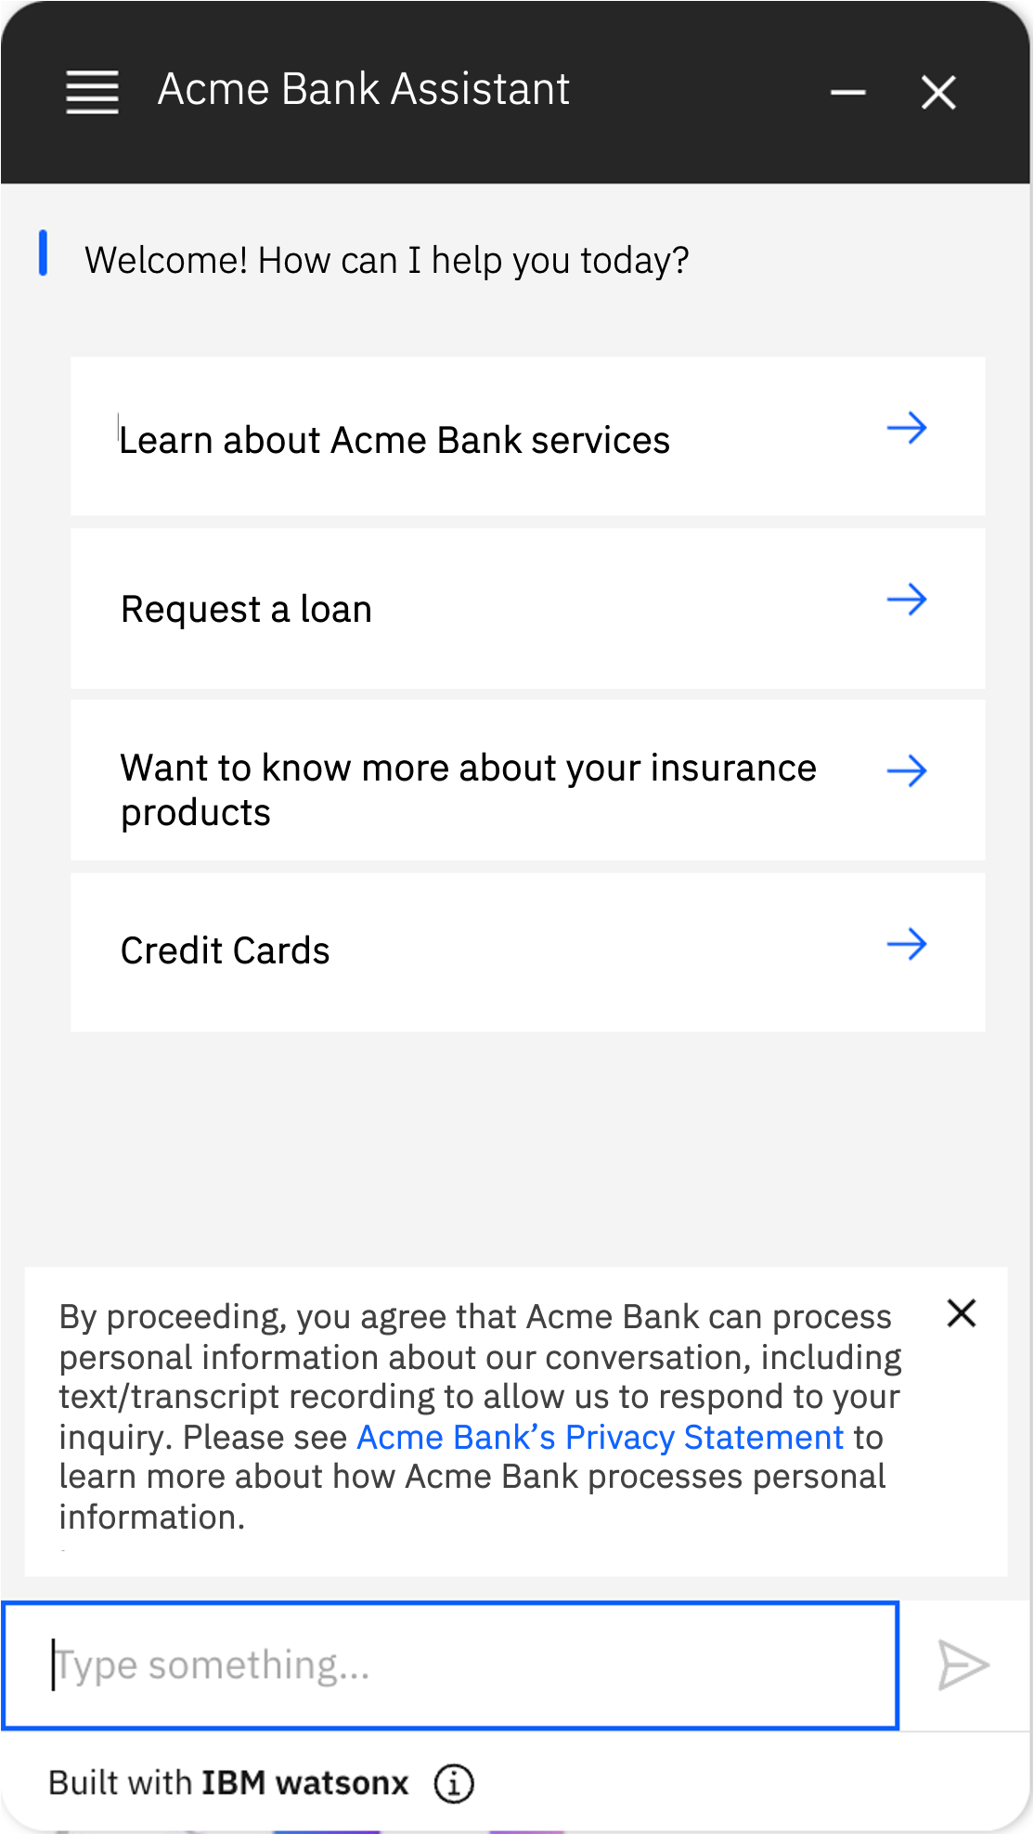
Let’s enrich a Large Language Model with this policy document…… and ask the question…
Acme Corp – Ask HR
LLM
(Mistral, Llama, Granite…)
Welcome John Doe! How can I help you today?
Learn about retirement plan
Ask for time-off
Initiate an employee transfer
RAG
(Retrieval-Augmented Generation)
Recruitment services
How many time-off days am I eligible to?
IBM Data&AI / © 2024 IBM Corporation
Notes:
Let’s use a chat bot interface to ask the question, assuming information about the connected employee and his hiring date is provided by the chat bot when interacting with the Large Language Model.
In this example John Doe, hired on November 1st 1999, is asking how many time-off days he is eligible to.
Let’s see it in action.

Slide 7
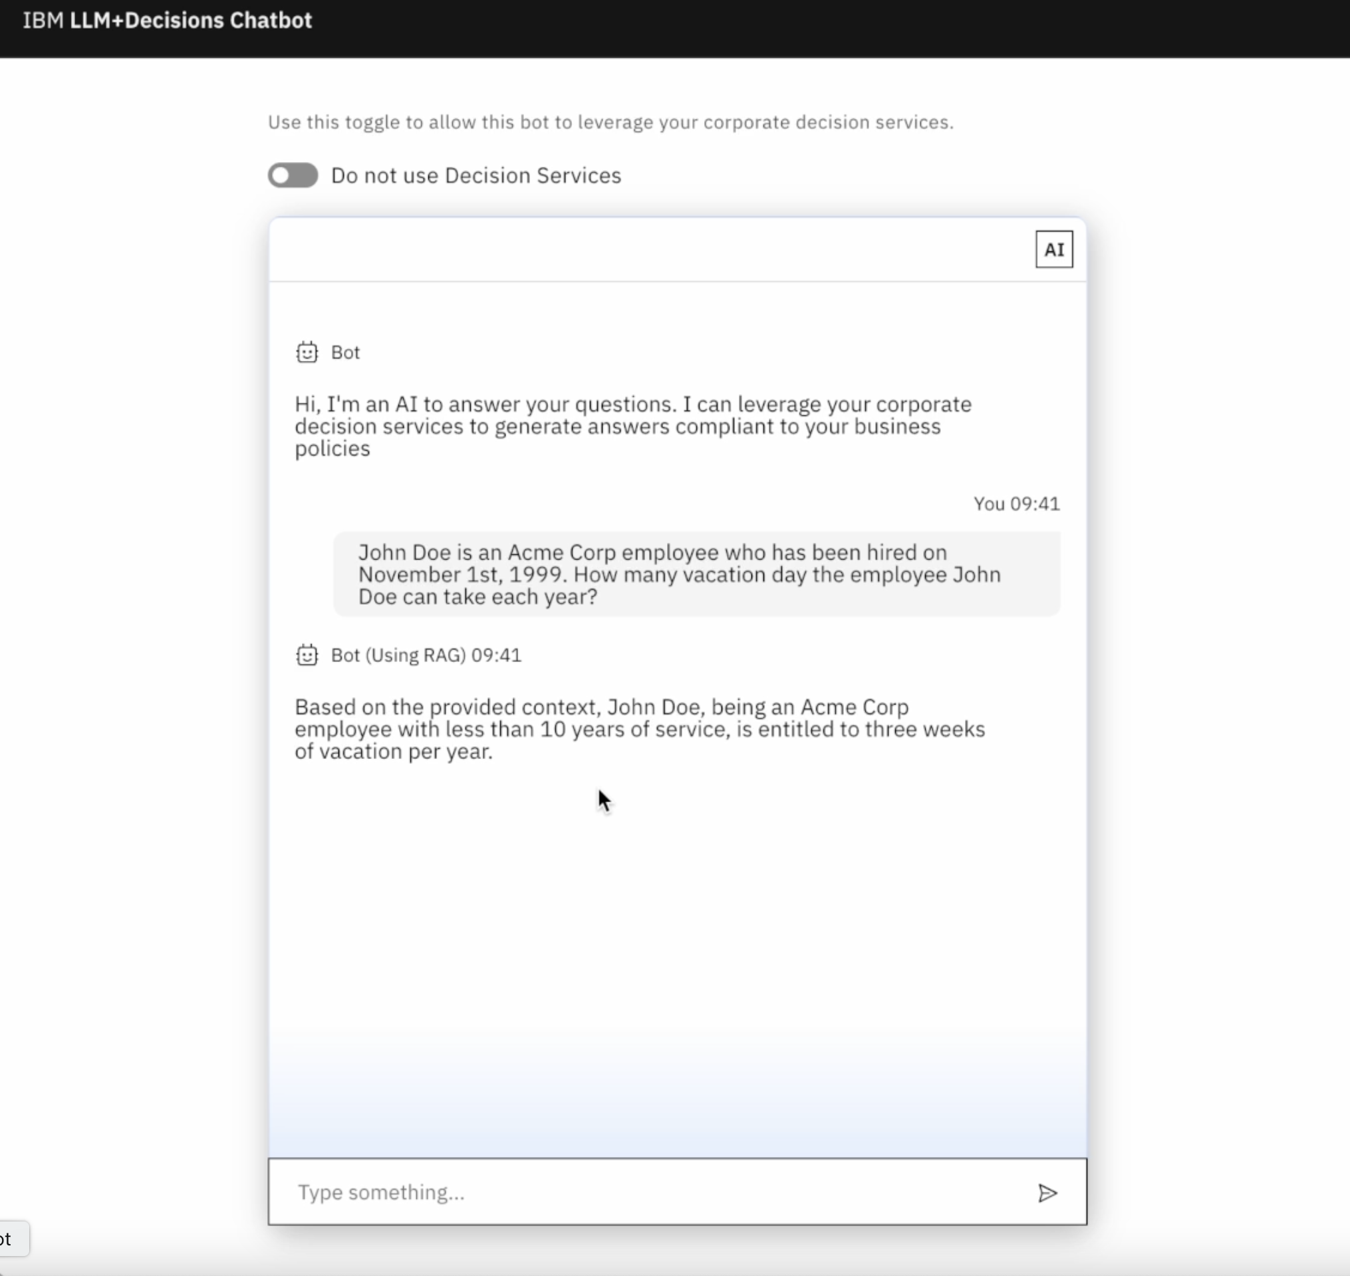
IBM Data&AI / © 2024 IBM Corporation
Notes:
In this demonstration, we explicitly ask the question. The question will be sent to a Large Language Model, Mistral from Mistral AI in this case, augmented with the Acme Corp policy document.
The LLM sends the response back to the chatbot interface.

Slide 8


Here is the answer…
Acme Corp – Ask HR
LLM
(Mistral, Llama, Granite…)
Welcome John Doe! How can I help you today?
Learn about retirement plan
Ask for time-off
Initiate an employee transfer
RAG
(Retrieval-Augmented Generation)
Recruitment services
How many time-off days am I eligible to?
You have been hired on November 1st, 1999. As an Acme Corp employee with less than 10 years of service, you are entitled to 3 weeks of vacation per year.
IBM Data&AI / © 2024 IBM Corporation
Notes:
The Large Language Model generated the answer from the information found in the policy document.

Slide 9
Acme Corp – Ask HR
LLM
(Mistral, Llama, Granite…)
Welcome John Doe! How can I help you today?
The answer is wrong!
Learn about retirement plan
Ask for time-off
Initiate an employee transfer
RAG
(Retrieval-Augmented Generation)
Recruitment services
How many time-off days am I eligible to?
You have been hired on November 1st, 1999. As an Acme Corp employee with less than 10 years of service, you are entitled to 3 weeks of vacation per year.
IBM Data&AI / © 2024 IBM Corporation
Notes:
As we can see, the returned answer is wrong. Against the facts, the Large Language Models states that John Doe as less than 10 years of service and is though entitled to 3 weeks, 15 days, of vacation.
The Large Language Model has not been able to deduce from the hiring date that John Does has more than 20 years of service and has been hired before January 1st, 2004.
This kind of mis-interpretation is detrimental in business scenario and could have significant consequences that may put the company out of compliance or could mis-guide an employee or a customer.

Slide 10
LLMs are not able to precisely interpret policies.
IBM Data&AI / © 2024 IBM Corporation
Notes:
Large Language Model are in general quite bad at interpreting business policies. Business policies are often based on context, common sense and precise rules that need to be interpreted logically. In this case, some calculation is involved to get the right number of time-off days. Computation and logical reasoning is currently not the sweet spot for Large Language Models.

Slide 11
LLMs are not able to precisely interpret policies.
How can we solve this problem?
IBM Data&AI / © 2024 IBM Corporation
Notes:
So, how can we solve the problem?

Slide 12
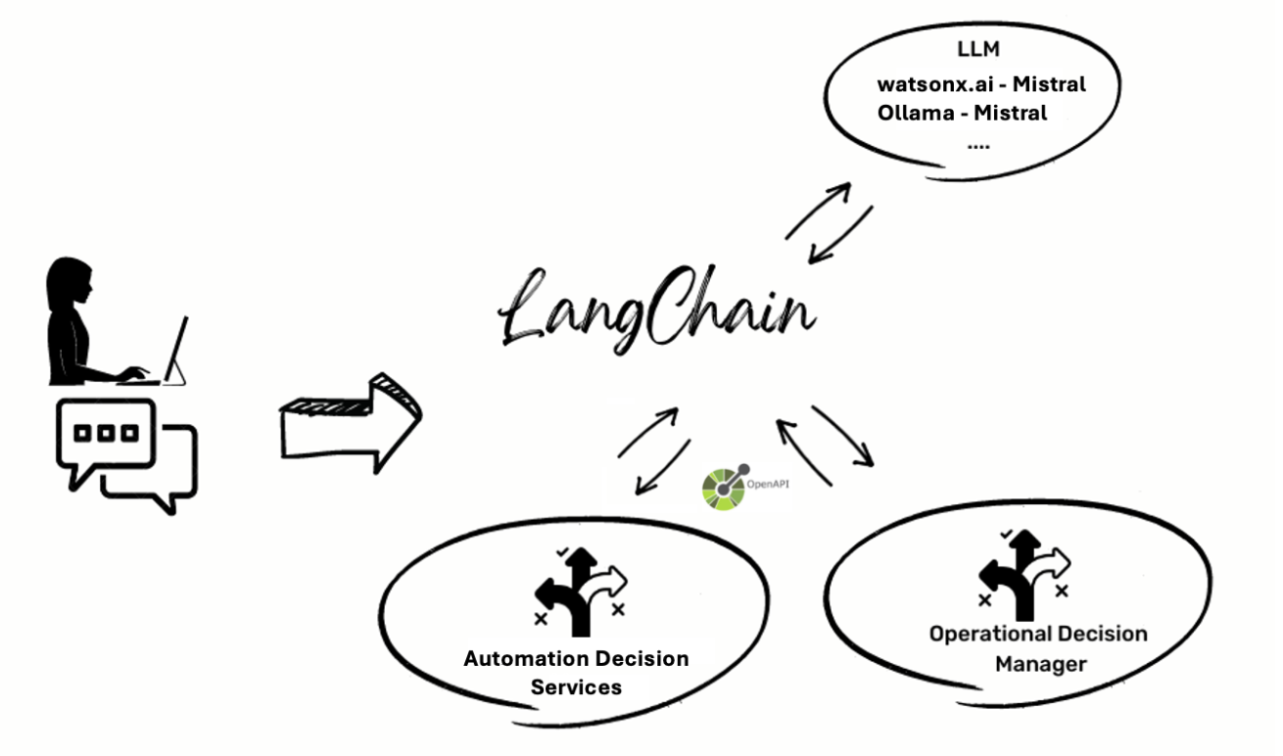
Let’s complement the LLM with a Rule Engine
IBM Automation Services and IBM Operational Decision Manager are 2 product to automate business decisions with rules
IBM Data&AI / © 2024 IBM Corporation
Notes:
One solution is to complement the Large Language Model with a rule engine able to interpret these business policies accurately and provide an answer compliant to what has been specified.
Operational Decision Manager and Automation Decision Services are two IBM products that allow to implement rule-based business decisions and enable lines of business to define and manage their policies.
LanChain is a popular framework that facilitates the implementation of Large Language Model-based applications by allowing to combine external services and Large Language Models to generate answers.
For questions for which a decision endpoint is relevant, the Large Language Model will identify the intent and the necessary data to invoke the endpoint and will use the answer to generate the final answer to the user.

Slide 13
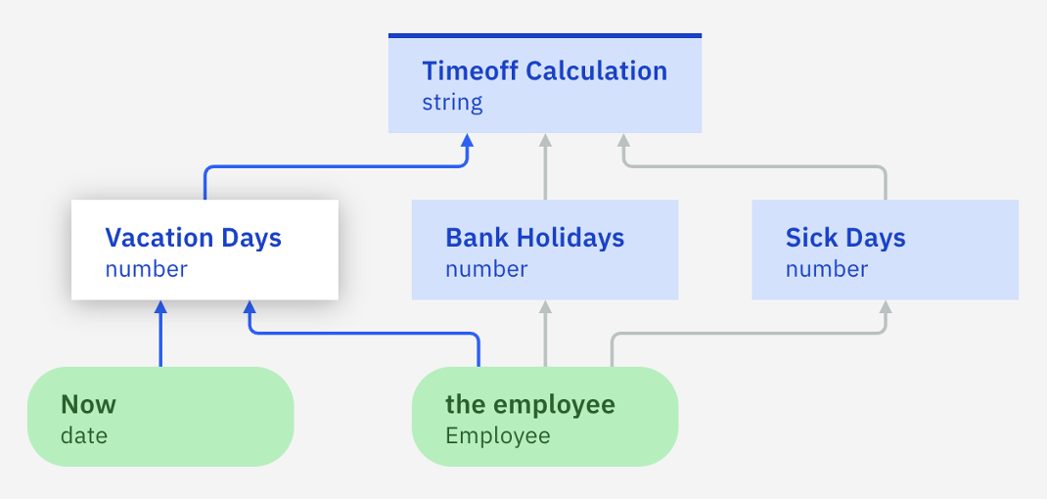
Let’s give the LLM access to a “decision service” encoding the policies as rules…
Acme Corp – Ask HR
LLM
(Mistral, Llama, Granite…)
Welcome John Doe! How can I help you today?
Learn about retirement plan
Ask for time-off
Initiate an employee transfer
Rule-based policies
Recruitment services
How many time-off days am I eligible to?
IBM Data&AI / © 2024 IBM Corporation
Notes:
Let’s see how it looks like when we combine a Large Language Model with a rule-based decision service implementing the time off policies.

Slide 14
…and ask the same question
Acme Corp – Ask HR
LLM
(Mistral, Llama, Granite…)
Welcome John Doe! How can I help you today?
Learn about retirement plan
Ask for time-off
Initiate an employee transfer
Rule-based policies
Recruitment services
How many time-off days am I eligible to?
You have been hired on November 1st, 1999. As an Acme Corp employee you get to enjoy 43 days of time off each year.
IBM Data&AI / © 2024 IBM Corporation
Notes:
Let’s ask the same question and see what the answer will be.

Slide 15
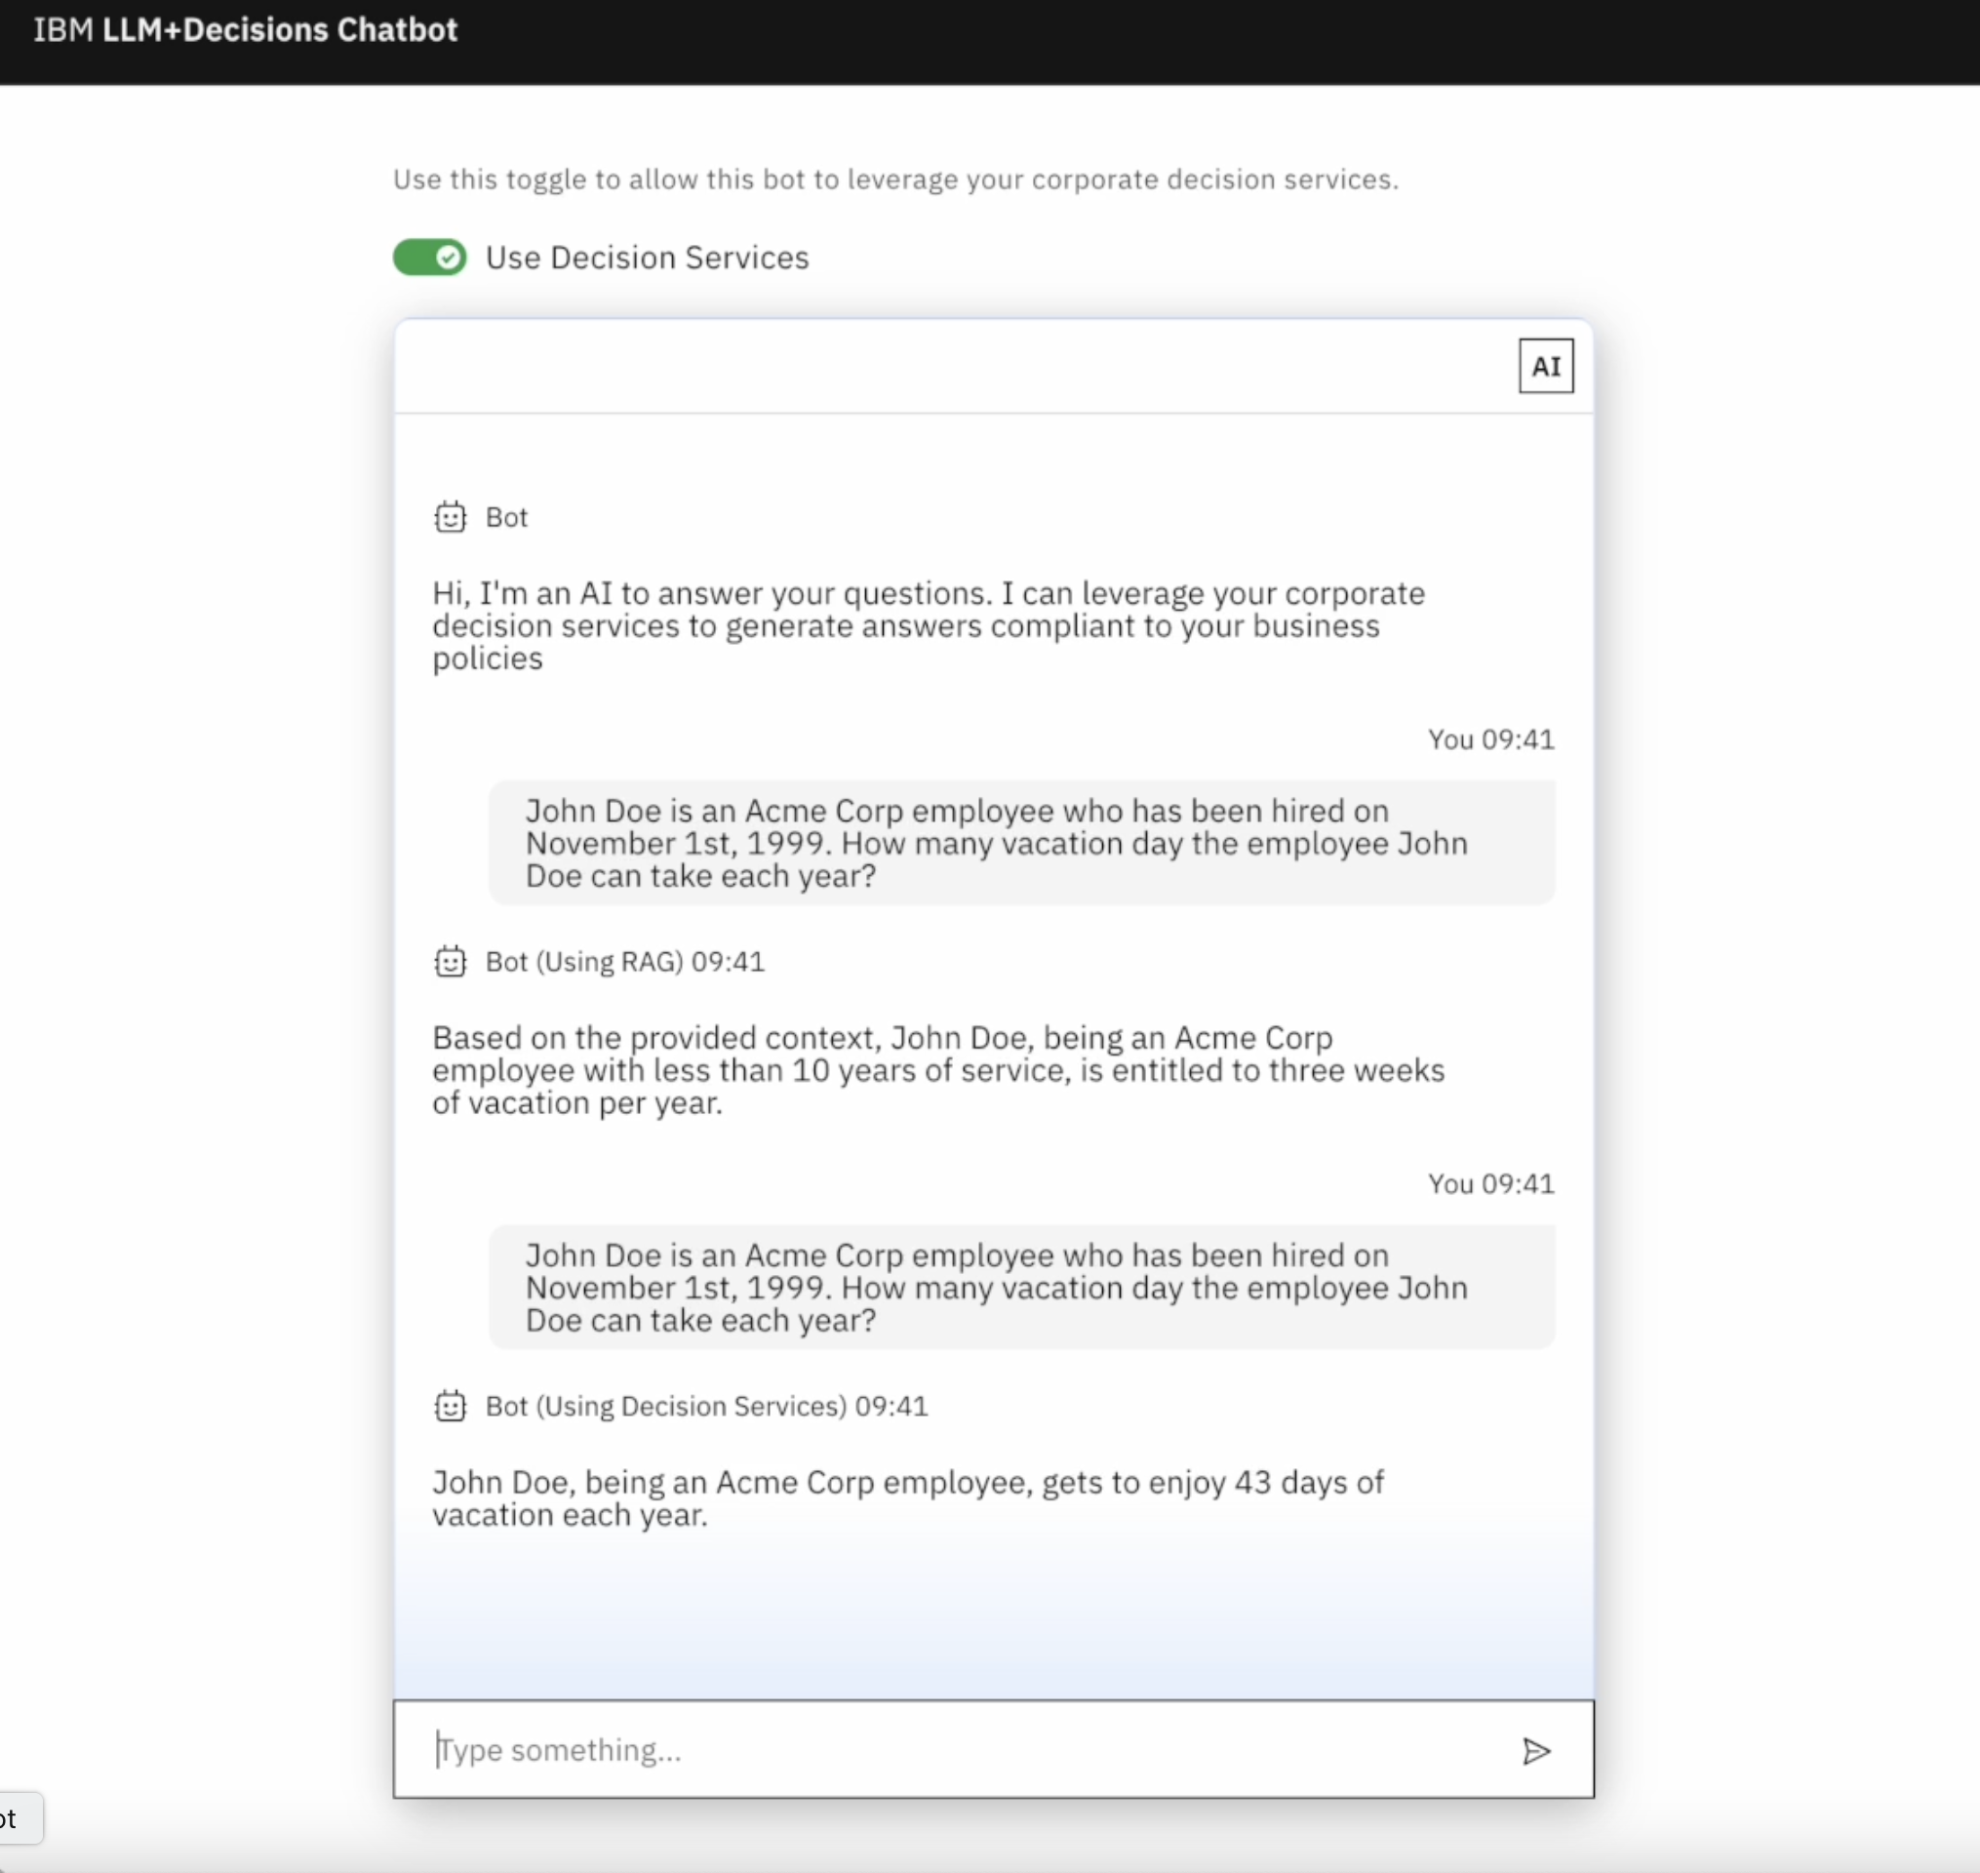
IBM Data&AI / © 2024 IBM Corporation
Notes:
Here the chat bot has been parameterized to invoke decision services in the backend if one is relevant to the question.
As we can see, the answer that we get is very different.

Slide 16
Acme Corp – Ask HR
LLM
(Mistral, Llama, Granite…)
Welcome John Doe! How can I help you today?
Now the answer is correct.
Learn about retirement plan
Ask for time-off
Initiate an employee transfer
Rule-based policies
Recruitment services
How many time-off days am I eligible to?
You have been hired on November 1st, 1999. As an Acme Corp employee you get to enjoy 43 days of time off each year.
IBM Data&AI / © 2024 IBM Corporation
Notes:
The answer is now correct! The business rules to precisely compute how many time-off days John Doe is eligible to have been applied and the generated answer is the result of the application of those rules.

Slide 17
How did we do that?
IBM Data&AI / © 2024 IBM Corporation
Notes:
Now let’s see how we implemented this solution

Slide 18

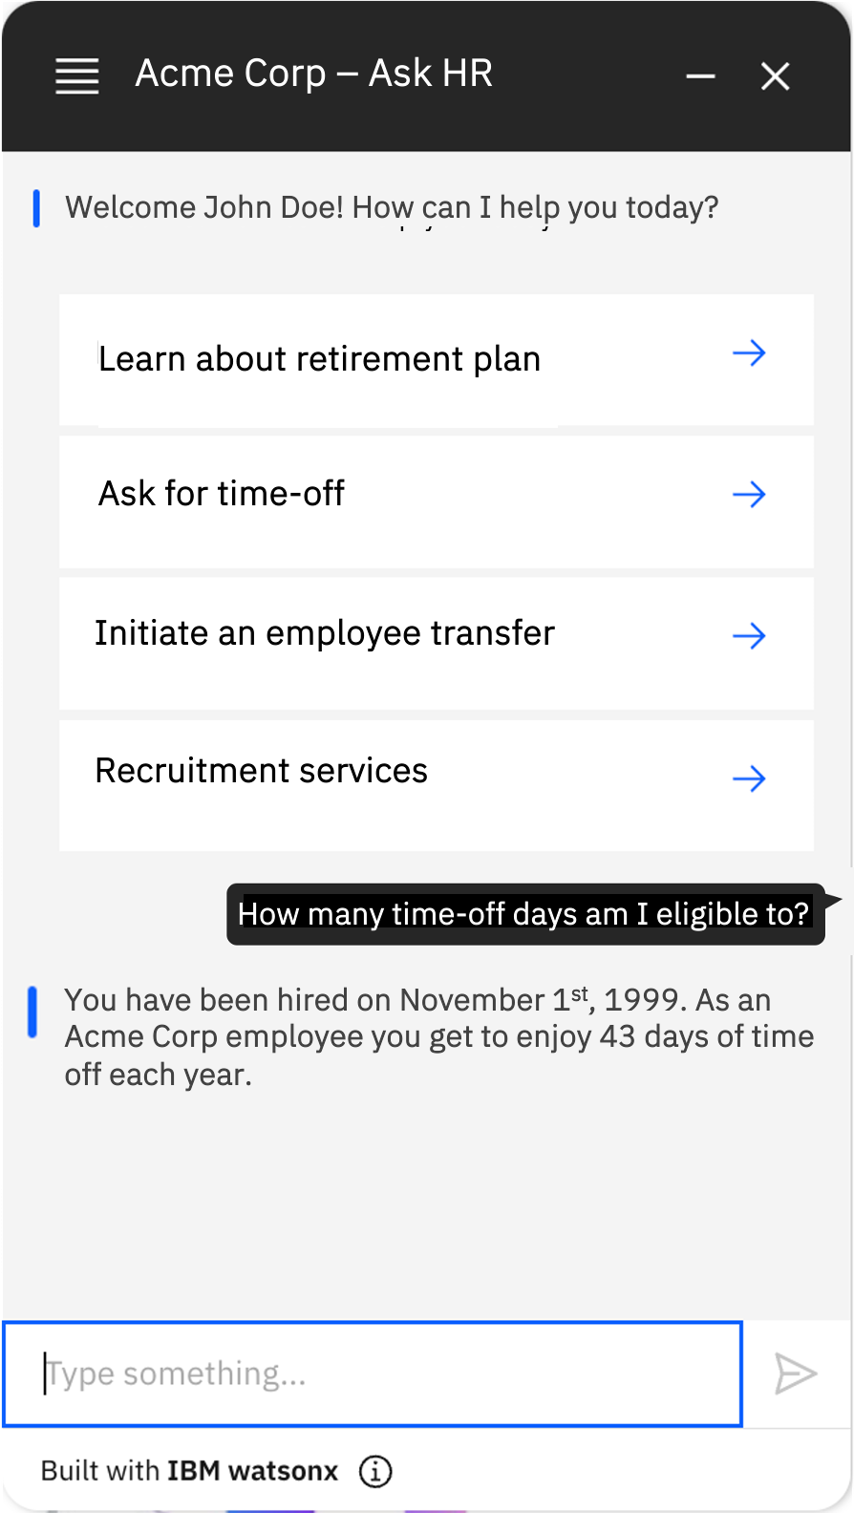

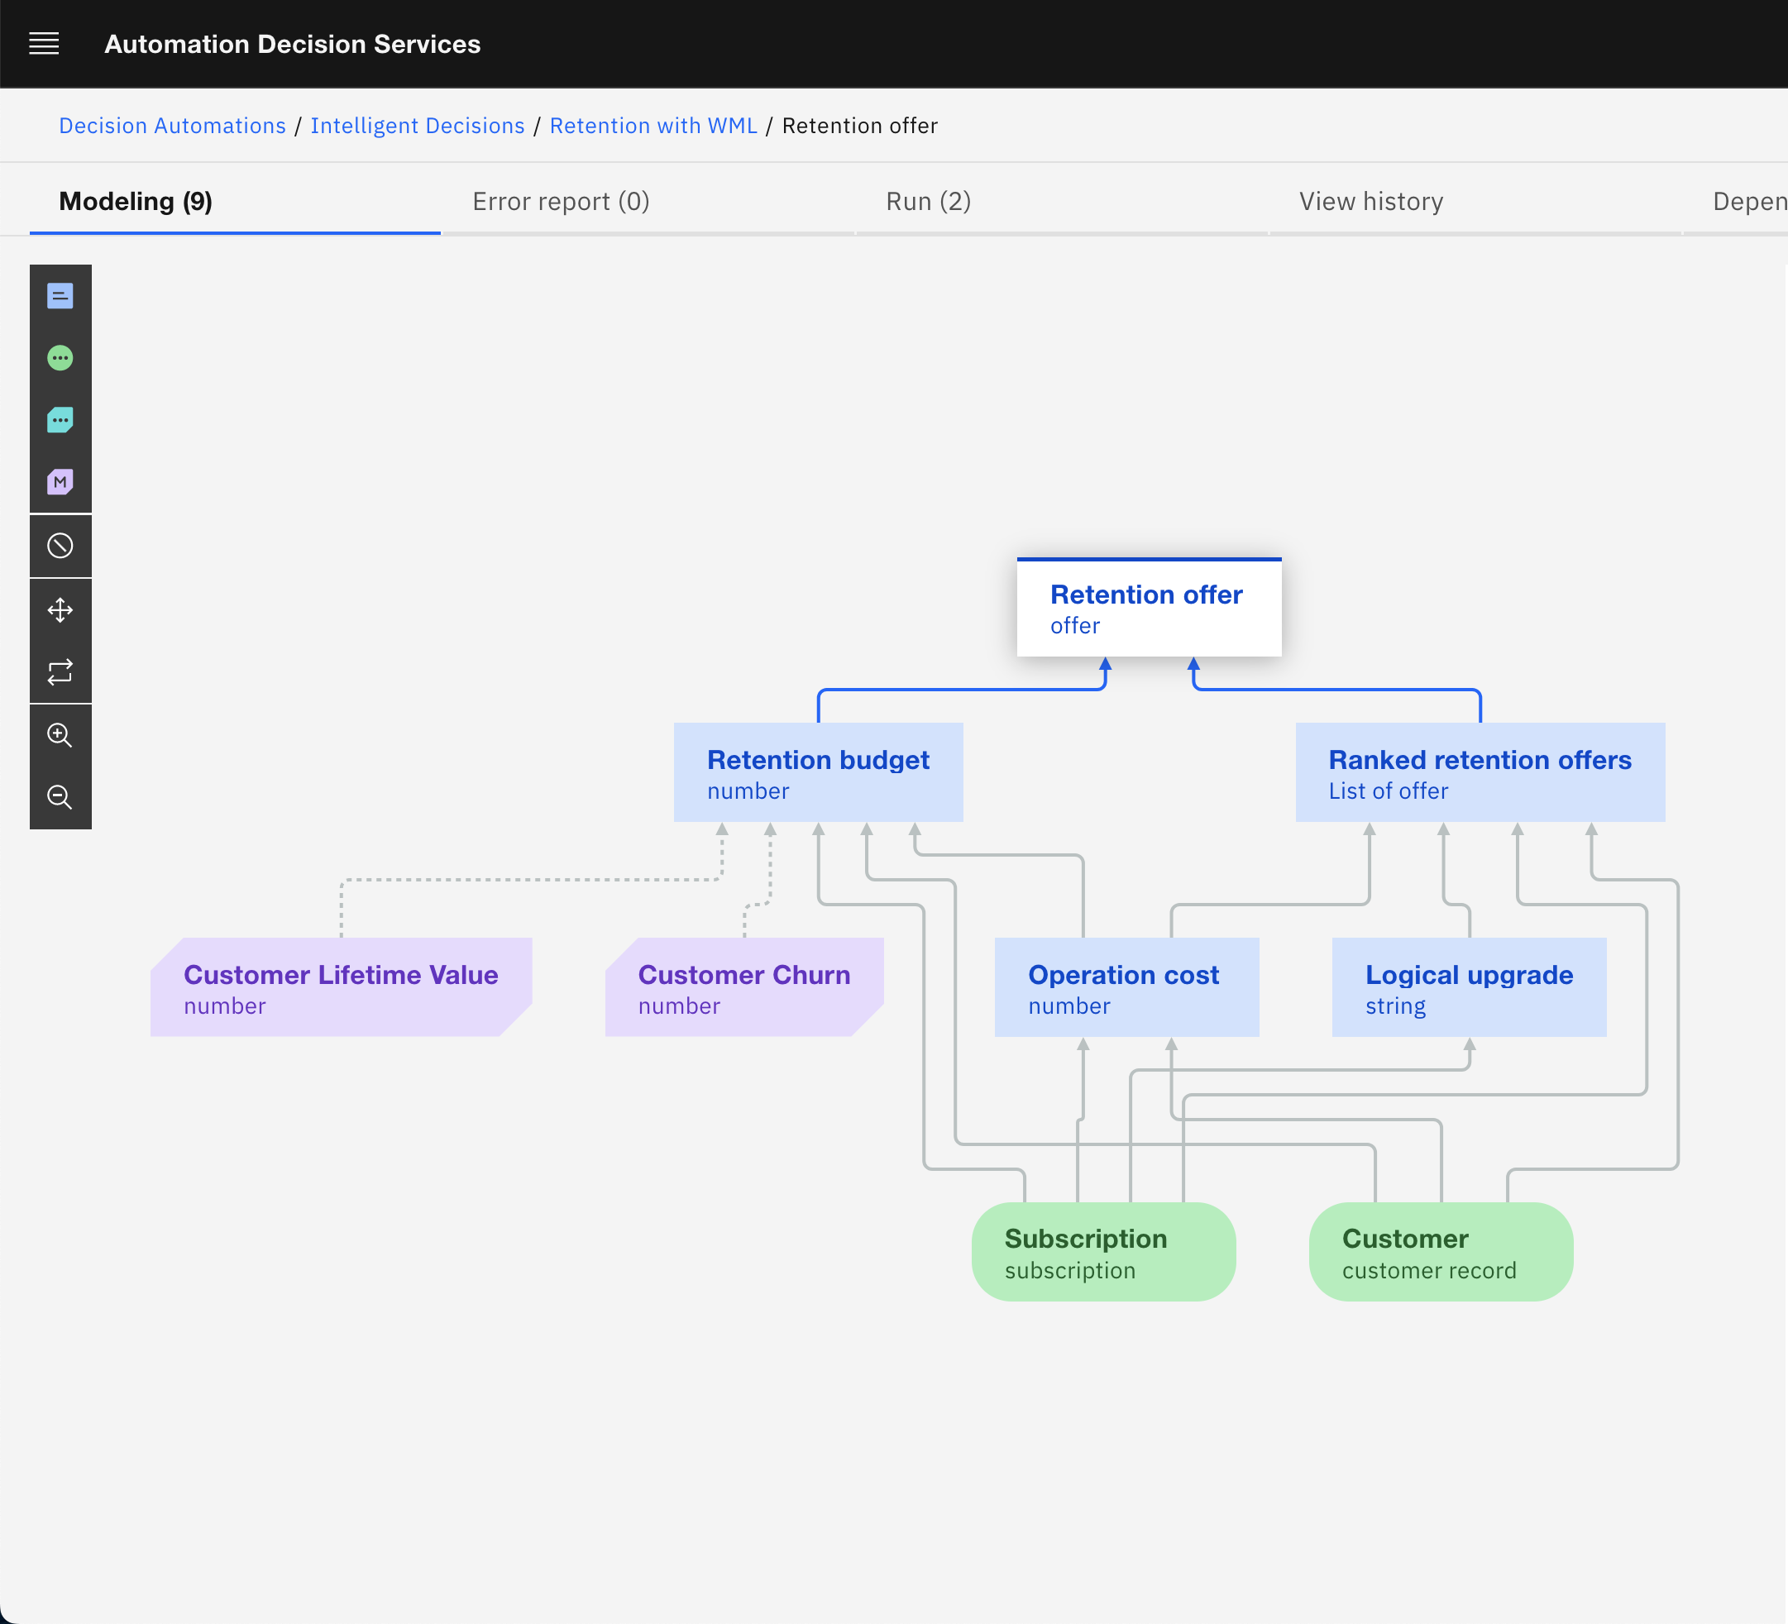
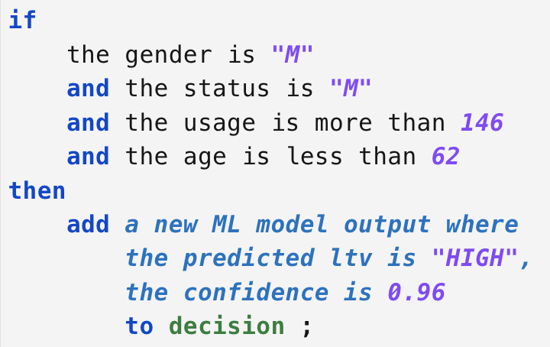
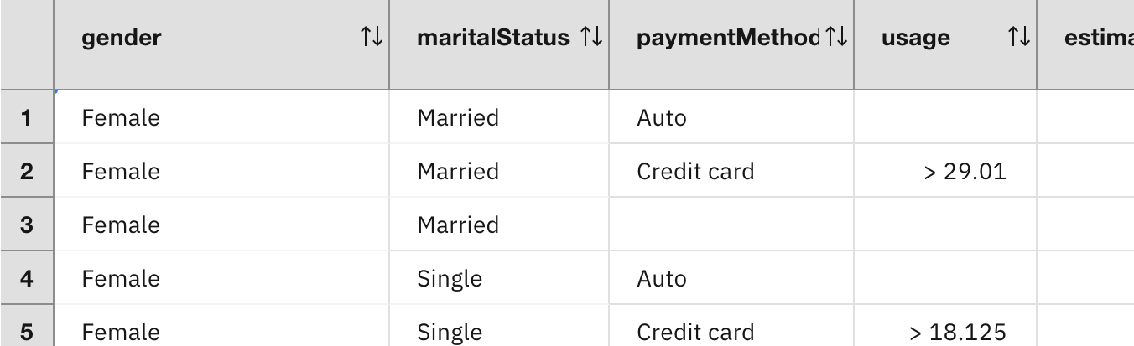
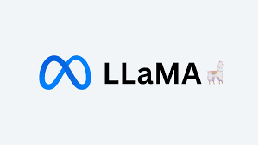


Augment LLMs with “tools” using prescriptive logic to answer questions
LangChain Application
Tool Descriptors
Decision Endpoint
REST API (Open API)
Chain
List of Decision Services
Ask the question
Invoke this tool with these args
This is the answer
Please answer considering these tools
This is the tool answer, please respond in NL
Right:
the response has been generated by the rule-based service which ensures compliance with corporate policies.
This is the answer
watsonx API (or other)
Large Language Model
IBM Automation Decision Services
or
IBM Operational Decision Manager
IBM Data&AI / © 2024 IBM Corporation
Notes:
As mentioned before, the middleware used between the Large Language Model, the rule engine and the chat interface is LangChain. LangChain orchestrates the interactions between the chat interface, the Large Language Model and IBM ODM which implements the rule-based policies.
Time-off policies are implemented as a decision service with business rules. The decision endpoint is exposed as a REST API which, given an employee, returns the number of time-off days he’s eligible to.
The decision service API is wrapped up a tool in LangChain to be used with a Large Language Model.
The Large Language Model is hosted in IBM watsonx.ai service and accessible to LangChain through a REST API. Major Large Language Models, like Mistral or IBM Granite, have been fine-tuned to use an external tool if available.
When the question is submitted to the backend, the Large Language Model is invoked with a description of the “tools” available to it.
The Large Language Model detects that one of the tool can be used to answer the question.
From its context, the question itself for instance, or the history of the conversation, it extracts the data points necessary to invoke the decision service, like the employee status or the hiring date.
The Large Language Model response to LangChain specifies which tool should be used and with which parameters.
LangChain invokes the decision service through its REST API and get back the answer determined by the rules. LangChain pass this answer back to the Large Language Model which generates the final answer to be sent back to the user.

Slide 19
Code
chatbot-frontend
rule-agent
IBM ODM (or ADS)
LangChain Application
Tool Descriptors
Decision Endpoint
REST API (Open API)
NodeJS chatbot backend
Chain
List of Decision Services
Ask the question
Invoke this tool with these args
This is the answer
Please answer considering these tools
This is the tool answer, please respond in NL
This is the answer
watsonx API (or other)
Large Language Model
IBM Automation Decision Services
or
IBM Operational Decision Manager
IBM watsonx.ai
IBM Data&AI / © 2024 IBM Corporation

Slide 20
User Input Processing Flow
IBM watsonx.ai
LLM identifies applicable tool
LLM extracts necessary tool parameters from user input and context
LLM answers with tool name & parameters
LLM generate an answer
LLM generate the final answer
Rule Agent
No
Invoke Decision Service
Ask LLM to generate the final answer with the tool response
Receive user question
Grab the list of available “tools”
Ask LLM if a tool is applicable
Yes
Tool identified?
IBM ODM
Apply Rules
IBM Data&AI / © 2024 IBM Corporation

Slide 21
Rule engines nicely complements Large Language Models to ensure answers are compliant to corporate policies and regulations
IBM Data&AI / © 2024 IBM Corporation
Notes:
As we saw in the demonstration, rule engines nicely complements Large Language Models to ensure answers are compliant to corporate policies and respect the regulation rules the company may have to apply.
The technical integration between the two is quite straightforward and illustrates how combining several types of AI, generative AI and prescriptive AI delivered by rule-based reasoners, can solve problems that are hard to tackle using generative AI only.

Slide 22
Rule engines nicely complements Large Language Models to ensure answers are compliant to corporate policies and regulations
How answers are generated is transparent, explainable, auditable and compliant
IBM Data&AI / © 2024 IBM Corporation
Notes:
Using prescriptive business rules to automate business decisions makes them transparent, explainable, auditable and compliant. AI is no more a black box generating answers that can’t be rigorously explained.
This is key in business scenarios where companies have to explain to their customers and sometimes auditors, how business decisions have been taken.

Slide 23

LLMs + Rules to ground generative AI to your corporate policies
Check out the demo: LLMs + LangChain + IBM ODM or IBM ADS
https://github.com/DecisionsDev/rule-based-llms
IBM Data&AI / © 2024 IBM Corporation
Notes:
This concludes this demonstration. We showed that Large Language Model plus rules is a way to ground AI-generated answers to your corporate policies and make sure your AI can be trusted and safe.
Please check-out the code of this demonstration by flashing this code and try out by yourself to discover how it could be applied to your business.

Slide 25
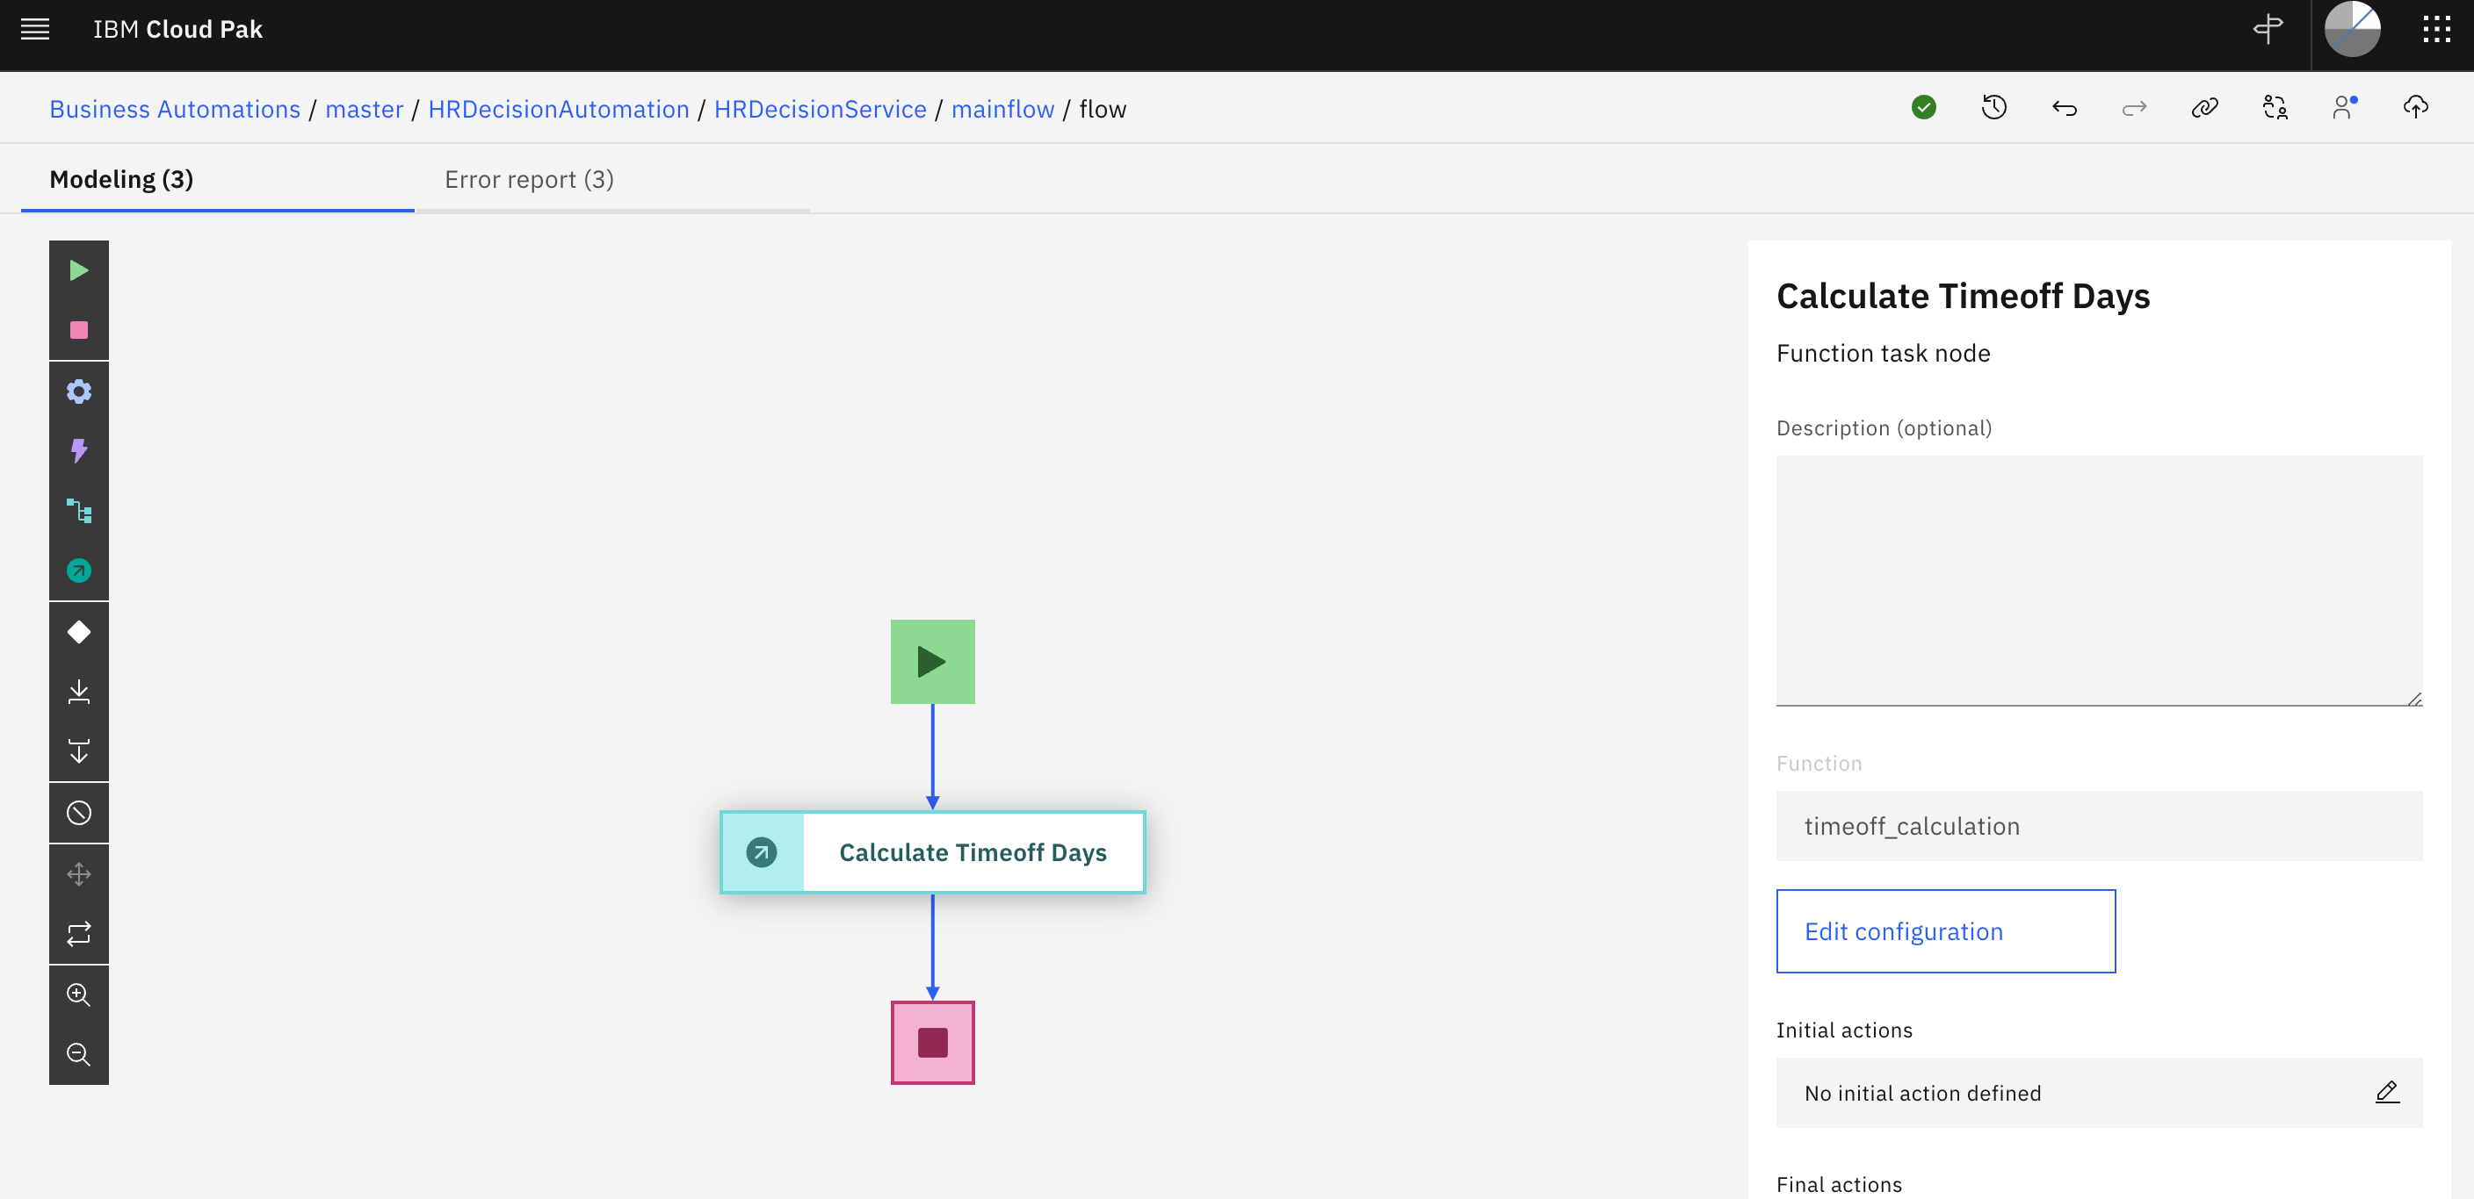

Slide 26
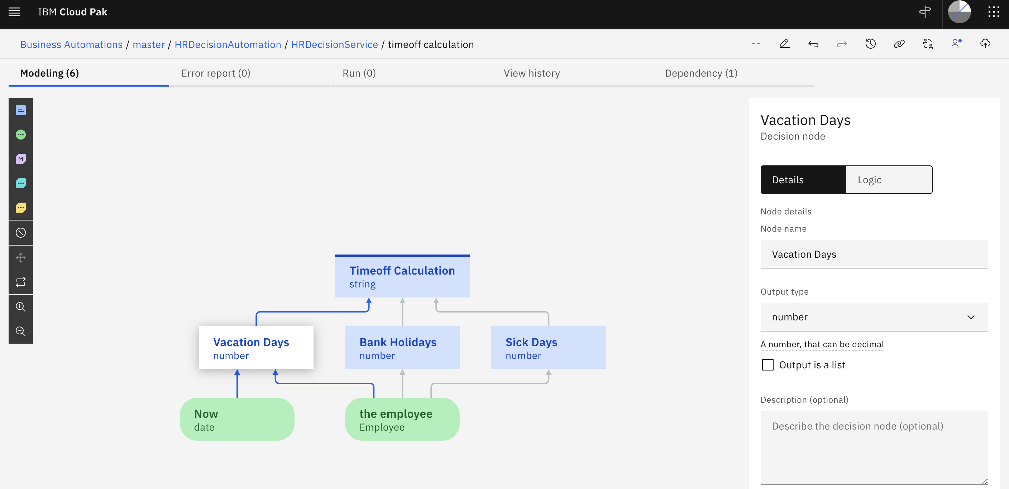

Slide 27
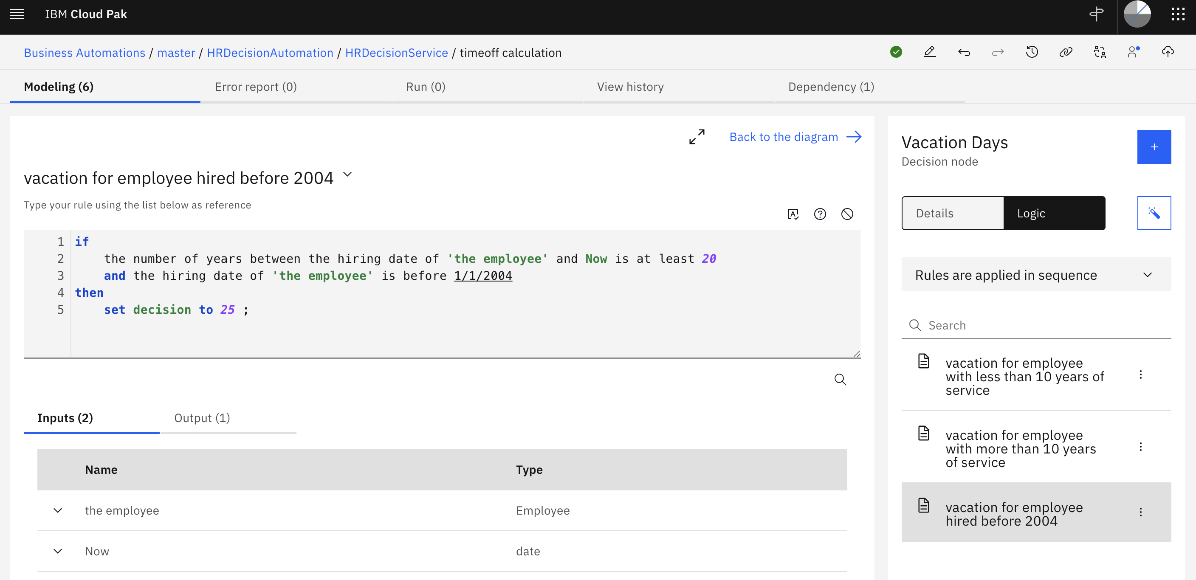

Slide 28
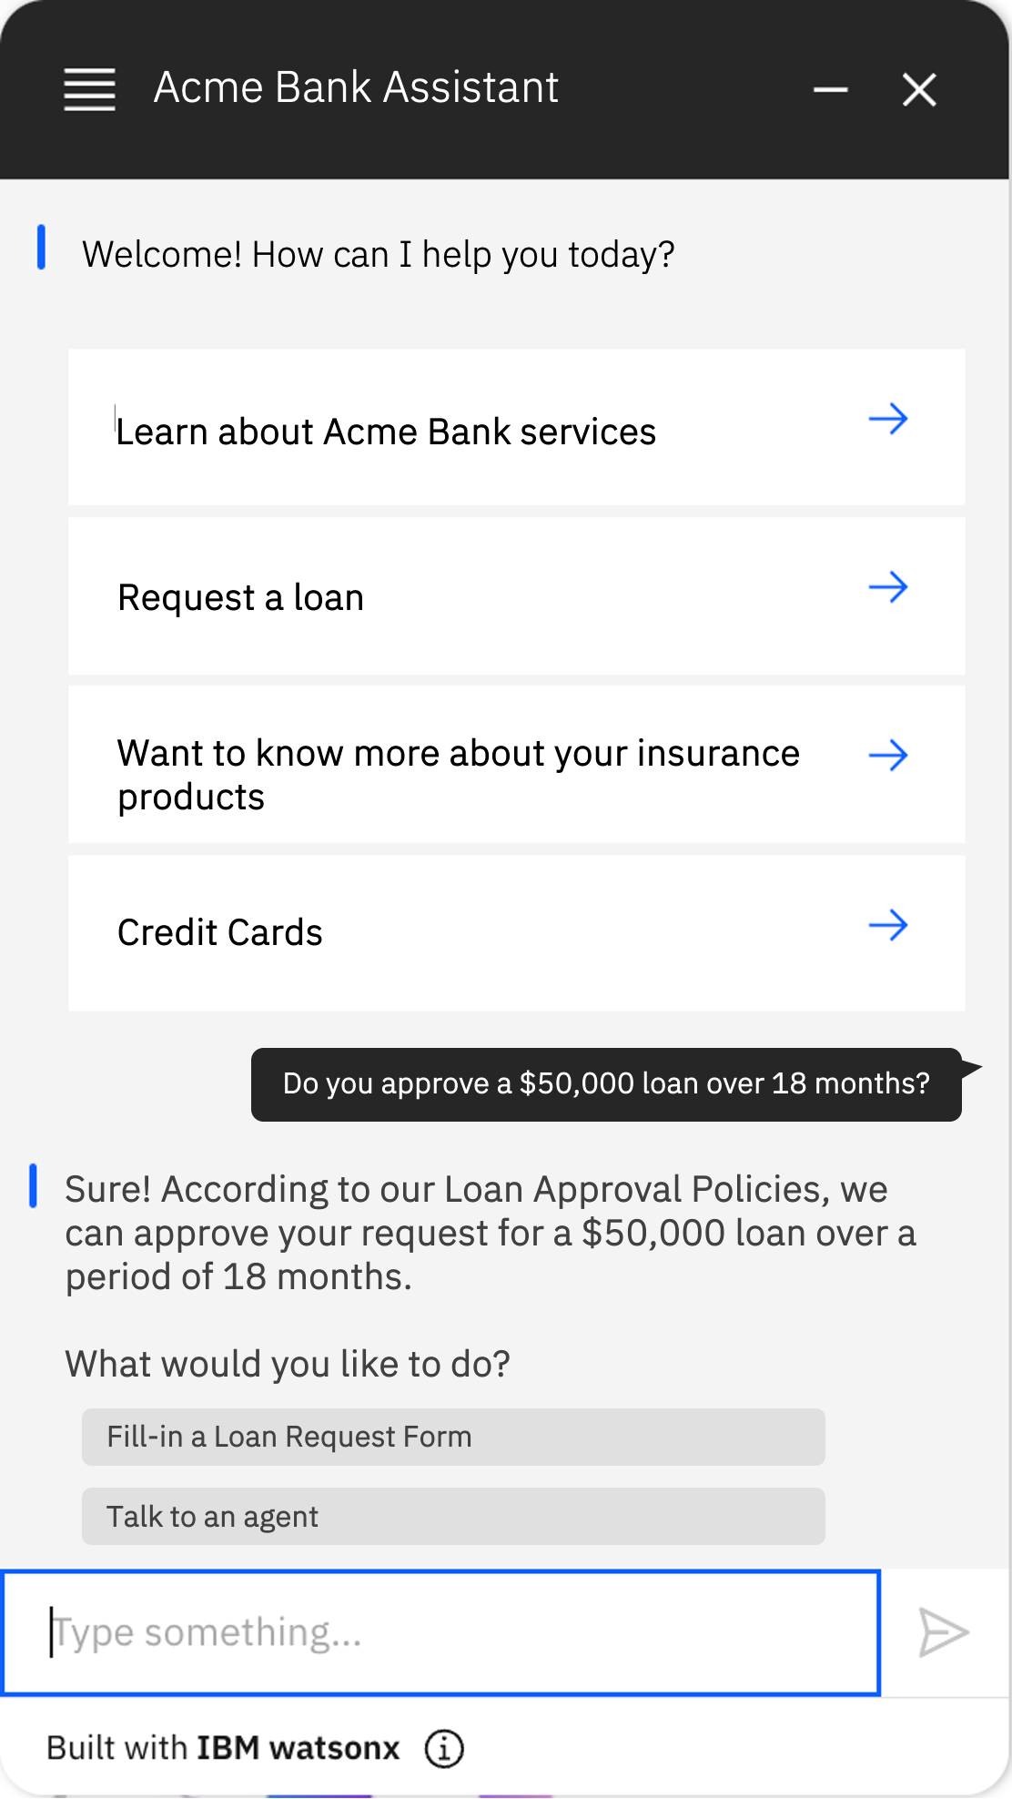
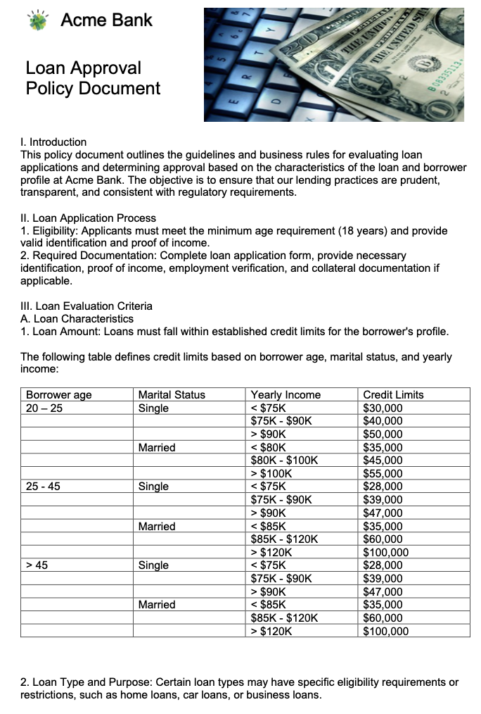
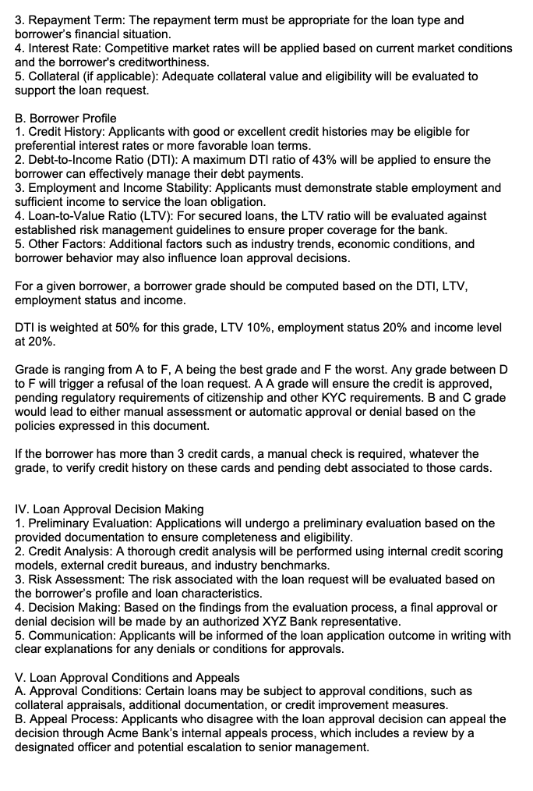
What happens with LLMs + RAG only?
Loan Approval Policies are documented in a corporate document maintained by the Credit business team.
LLM with RAG over the policy document and borrower info
Wrong: the LLM didn’t figure out how to compute the borrower grade from DTI ratio and LTV.
Response has been hallucinated.
Loan request should have been denied.
Do you approve a $50,000 loan over 18 months?

Slide 29
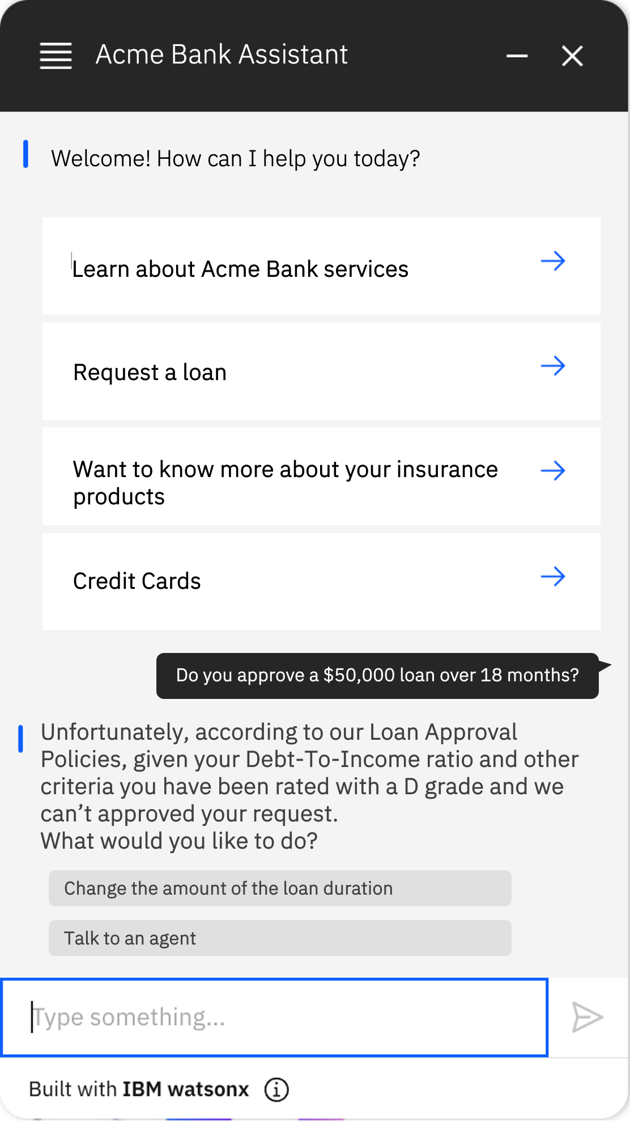
Ground LLMs answers to corporate policies
Solution: enhancing LLM with formal rule-based decisions
LLM leveraging Decision Endpoints implementing the business policies as formal rules
Decision Endpoint
Tools
Right: the response has been generated by the rule-based service which ensure compliance with corporate policies.
Do you approve a $50,000 loan over 18 months?
IBM Automation Decision Services

